Slide 1
QoS Defined
The goal :
  Provide some level of predictability and control beyond the current IP “best-effort” service
Fundamental principle
  Leave complexity at the “edges” and keep network “core” simple

Slide 2
QoS Metrics
Performance attributes
  Service availability
  Delay
  Delay variation (jitter)
  Throughput
  Packet loss rate
Vary according to Service Level Agreement (SLA)

Slide 3
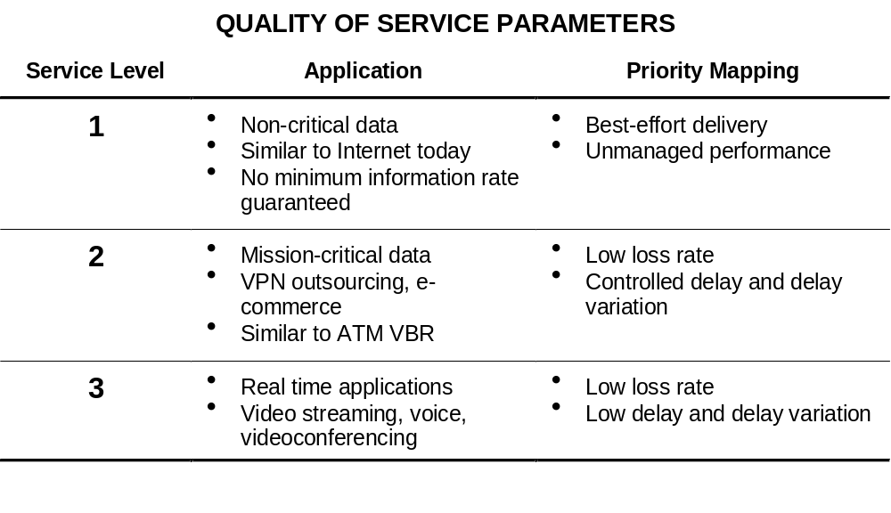
Service Level Agreements (SLA)

Slide 4
QoS Protocol Classification
QoS can be achieved by :
  Resource reservation (integrated services)
  Prioritization (differentiated services)
QoS can be applied :
  Per flow (individual, uni-directional streams)
  Per aggregate (two or more flows having something in common)

Slide 5
Best Effort vs. QoS
Best Effort:
    You get a link to the Internet with at most B bits/sec.
    If you don’t like it, switch to another provider.
Quality of Service (QoS)
  We provide you some kind of guarantees for:
    Bandwidth
    Latency
    Jitter
  I.e., network is engineered to provide some Quality beyond “Not to exceed B bits/s”

Slide 6
Two Styles of QoS
Worse-case
  Provide bandwidth/delay/jitter guarantee to every packet
  E.g., “hard real time”
Average-case
  Provide bandwidth/delay/jitter guarantee over many packets
  Statistical in nature
  E.g. “Soft real time”

Slide 7
Resource Reservation: Example
Src
Router
Router
Dest
10 Mbps
available
4 Mbps
available
6 Mbps
available
Case 1: Source attempts to connect to destination, and attempts to
reserve 4 Mbps for the connection
Result: Connection accepted. There is enough bandwidth
available. Available link bandwidths updated.
Case 2: Source attempts to connect to destination, and attempts to
reserve 5 Mbps for the connection
Result: Failure. There is not enough bandwidth available on
one of the links.

Slide 8
Resource Reservation (cont’d)
Once a connection is accepted, the host must use only the amount of resources reserved. It may not use more than that.

Slide 9
Leaky Bucket
Used in conjunction with resource reservation to police the host’s reservation
At the host-network interface, allow packets into the network at a constant rate
Packets may be generated in a bursty manner, but after they pass through the leaky bucket, they enter the network evenly spaced

Slide 10
Leaky Bucket: Analogy
Packets from host
Leaky
Bucket
Network

Slide 11
Leaky Bucket (cont’d)
The leaky bucket is a “traffic shaper”: It changes the characteristics of packet stream
Traffic shaping makes more manageable and more predictable
Usually the network tells the leaky bucket the rate at which it may send packets when the connection begins
Polices the average rate

Slide 12
Leaky Bucket:
Doesn’t allow bursty transmissions
In some cases, we may want to allow short bursts of packets to enter the network without smoothing them out
For this purpose we use a token bucket, which is a modified leaky bucket

Slide 13
The Leaky Bucket Algorithm
The Leaky Bucket Algorithm
  used to control rate in a network.
  It is implemented as a single-server queue
    with constant service time.
  If the bucket (buffer) overflows then packets are discarded.
Leaky Bucket (parameters r and B):
  Every r time units: send a packet.
  For an arriving packet
    If queue not full (less than B) then enqueue
Note that the output is a “perfect” constant rate.
QoS
#<number>

Slide 14
Token Bucket
The bucket holds tokens instead of packets
Tokens are generated and placed into the token bucket at a constant rate
When a packet arrives at the token bucket, it is transmitted if there is a token available. Otherwise it is buffered until a token becomes available.
The token bucket has a fixed size, so when it becomes full, subsequently generated tokens are discarded

Slide 15
Token Bucket
Packets from host
Token Generator
(Generates a token
once every T seconds)
Network

Slide 16
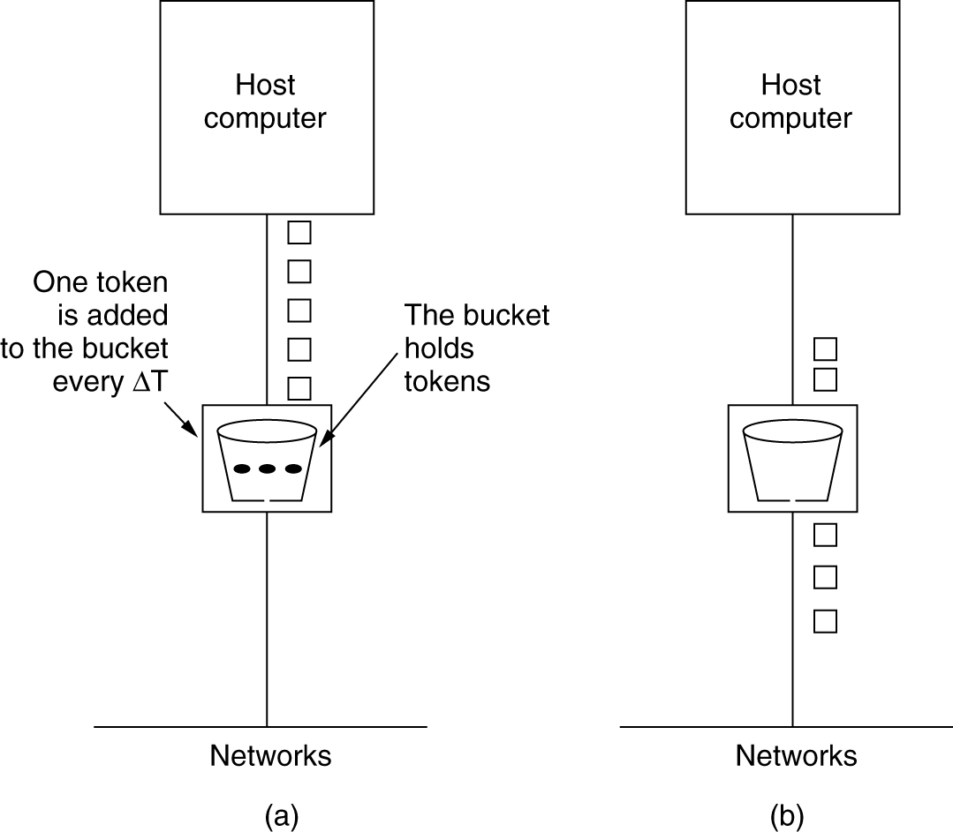
The Token Bucket Algorithm
5-34
(a) Before. (b) After.
QoS
#<number>

Slide 17
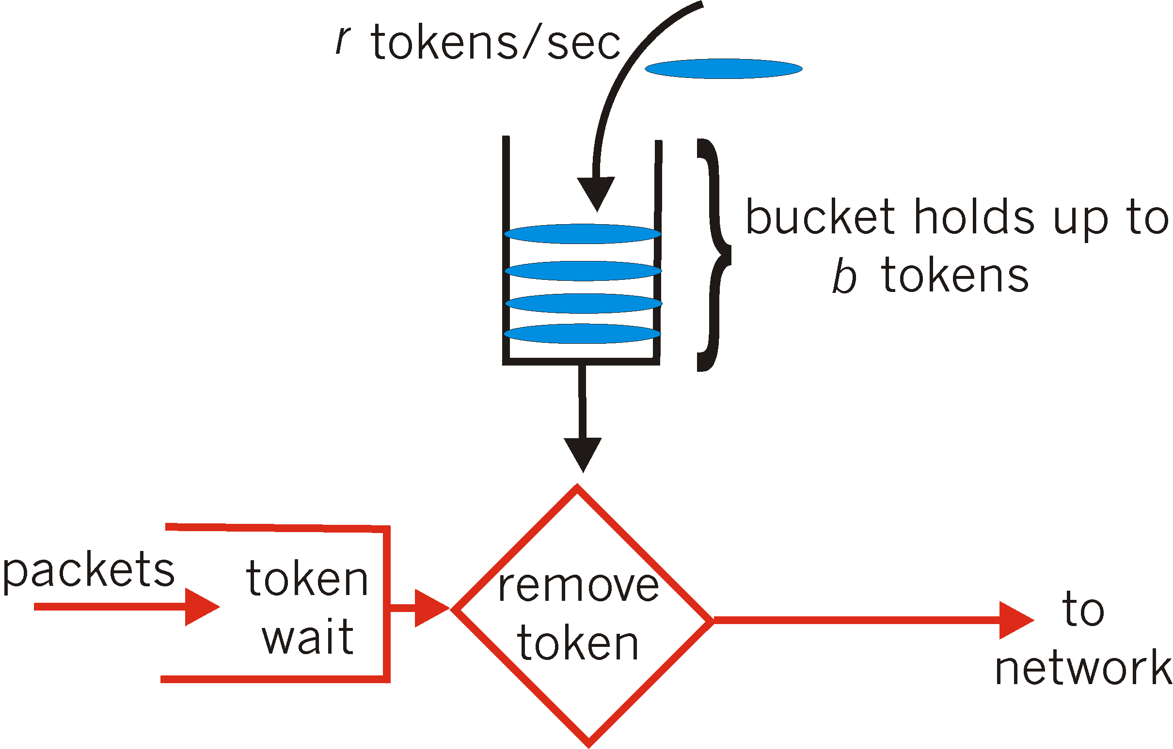
Token bucket example
arrival | queue | Token bucket | sent
p1 (5) | - | 0 | -
p2 (2) | p1 | 3 | -
p3 (1) | p2 | 6-5=1 | p1
 |  | 4-2-1=1 | p3,p2
 |  | 4
 |  | 6
parameters:
MaxTokens=6
1/r=3 (=3 token/time)
QoS
#<number>
Notes:
Need to change to start with a full bucket

Slide 18
Flow Specification: Token Bucket
Characterized by two parameters (r, b)
  r – average rate
  b – token depth
Assume flow arrival rate <= R bps (e.g., R link capacity)
A bit is transmitted only when there is an available token
Arrival curve – maximum amount of bits transmitted by time t
r bps
Arrival curve
bits
slope r
b
b bits
slope R
<= R bps
time
regulator

Slide 19
Token Bucket Algorithm
Highlights:
  The bucket holds tokens.
  To transmit a packet, we “use” one token.
Allows the output rate to vary,
  depending on the size of the burst.
  In contrast to the Leaky Bucket
Granularity
  Packets (or bits)
Token Bucket
(r, MaxTokens):
  Generate a token every r time units
    If number of tokens more than MaxToken, reset to MaxTokens.
  For an arriving packet: enqueue
  While buffer not empty and there are tokens:
    send a packet and discard a token
QoS
#<number>

Slide 20
Quality of service issues
Flow specification
  Flow spec: traffic characteristics, QoS requirements (delay, jitter,bandwidth)
Routing
  Routing traffic to best meet demand
Resource reservation
  End-host signaling to network QoS resource requirements
Admission control
  Limiting number of reservations
Packet scheduling
  Packet by packet scheduling (fairness, delay)
RSVP addresses reservation

Slide 21
Service Classes
Multiple service classes
Service: contract between network and communication client
  End-to-end service
  Other service scopes possible
Three common services
  Best-effort (“elastic” applications)
  Hard real-time (“real-time” applications)
  Soft real-time (“tolerant” applications)

Slide 22
Worse-case : Guaranteed Services
Service contract
  Network to client: guarantee a deterministic upper bound on delay for each packet in a session
  Client to network: the session does not send more than it specifies
Algorithm support
  Admission control based on worst-case analysis
  Per flow classification/scheduling at routers

Slide 23
Average-case: Controlled Load Service
Service contract:
  Network to client: Average delay, jitter, bandwidth, e.g., makes network appear as an unloaded, best effort network with bandwidth and delay
  Client to network: the session does not send more than it specifies
Algorithm Support
  Admission control based on measurement of aggregates
  Scheduling for aggregate possible

Slide 24
RSVP
The ReSerVation Protocol

Slide 25
What is RSVP
Protocol that guarantees QoS
It reserves resources in the internet (resources include BW and router buffers)
Can also be used by routers to forward BW reservation requests
RSVP: It is a network control protocol that allows data receiver to request a special end to end quality of service for its data flows.

Slide 26
What is RSVP
Although it sits on top of the IP protocol stack, it is not a routing protocol
It is rather an internet control protocol
It is designed to operate with current and future unicast and multicast routing protocols

Slide 27
During reservation setup, an RSVP QOS request is passed to two local decision modules: 1. Admission control 2. Policy control.
Admission Control: Determines whether the node has sufficient available resources to supply the requested resources.
Policy Control: Determines whether the user has administrative permission to make the reservation.

Slide 28
If both checks succeed, parameters are set in the packet classifier and in the link layer interface to obtain the desired QOS.
If either checks fails, the RSVP program returns an error notification to the application process that generated the request.

Slide 29
Since the membership of a large multicast group and the resulting tree are likely to change with time,the RSVP protocol specifies the creation of “soft states” , that can be built and destroyed incrementally in the routers and the hosts.
For this RSVP periodically sends refresh messages to maintain the state along the reserved paths.

Slide 30
RSVP Messages
Message Types:
  RSVP messages are IP packets with PID = 46
  A Common Header payload object identifies the type:
      PATH
        originates with sender, provides flow description
        forwarded from source to destination (sender to receiver)
        carries flowspec and, optionally, Adspec

Slide 31
RSVP Messages
      RESV
        originates with receiver, carries resource reservation, RSpec
        forwarded hop-by-hop using local PHOP addresses
      PathErr
      ResvErr
      PathTear
        instructs nodes to remove path state
      ResvTear
        instructs nodes to remove resource reservation state
      ResvConf
        optional reservation confirmation from sender to receiver

Slide 32
RSVP Messages
Protocol
  Sender initiates PATH message:
    Previous HOP address
    Sender Template provides a filter spec for the flow
    Sender TSpec which describes the traffic characteristics of the flow
    optional AdSpec which is a list of the QoS capabilities at each network entity

Slide 33
RSVP Messages
Protocol
  PATH message is forwarded, hop-by-hop
  At each network entity (hop):
    stores the PATH state information (e.g. PHOP, flowspec, AdSpec, …)
    sets the PHOP to its own IP address
    optionally adds an entry to the AdSpec
    forwards the PATH message to the next hop
Sender
Forwarding
Node
Forwarding
Node
Forwarding
Node
Receiver
PATH
PATH
PATH
PATH

Slide 34
RSVP Messages
  Receiver receives a PATH message:
      forms an RSpec from the Sender TSpec, and, optionally, from the AdSpec list of the QoS capabilities of each network entity along the sender path
      e.g. TSpec might provide token bucket, peak rate, MTU parameters
      e.g. AdSpec might provide bandwidth, and latency estimates for each hop

Slide 35
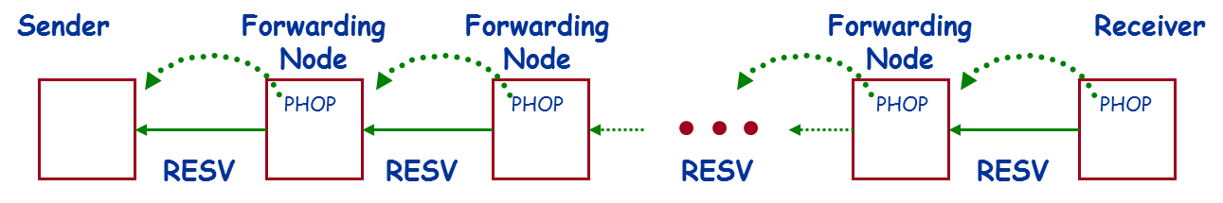
RSVP Messages
  Receiver returns a RESV message:
      flowspec: RSpec and filter spec
      returned along path identified by PHOPs stored at each network entity in path state
      at each network entity, the RESV state is stored, filters are set up and resources are allocated to support the requested QoS
      if requested (by a flag in the RESV message), a RESV confirm is returned by the sender to the receiver

Slide 36
Soft State
There is a timer associated with every reservation of BW stored in a router
It should be periodically refreshed.
Same principle is used for routing tables where the entries are refreshed by newly arriving data packets

Slide 37
RSVP Problems
If route changes, reservation must be made along new route
  New reservation takes time to setup
  New reservation might fail
  Old route could still be working fine
Reservation failure
  Primary route has inadequate bandwidth although secondary has enough

Slide 38
IETF Intserv
Focus on per-flow QoS.
  Support specific applications such as video streaming.
  Based on mathematical guarantees.
Many concerns:
  Complexity
  Scalability
  Business model
  Charging

Slide 39
Components of Integrated Services
Type of service model
  What does the network promise?
Service interface
  How does the application describe what it wants?
Packet scheduling
  How does the network meet promises?
Establishing the guarantee
  How is the promise communicated to/from the network?
  How is admission of new applications controlled?

Slide 40
Service Models
Network can support traffic streams with different “quality of service”.
  Best effort
  Predictive or differentiated services
  Strong guarantees on the level of service (real-time)
The set of services that is supported on a specific network can be viewed as a service model.
  Model that can be used to select a service
    E.g., cost versus performance tradeoffs
  Network architecture that supports the set of services
    Considers interactions between services

Slide 41
Service Models
Guaranteed service
  Targets hard real-time applications.
  User specifies traffic characteristics and a service requirement.
  Requires admission control at each of the routers.
  Can mathematically guarantee bandwidth, delay, and jitter.
Controlled load.
  Targets applications that can adapt to network conditions within a certain performance window.
  User specifies traffic characteristics and bandwidth.
  Requires admission control at each of the routers.
  Guarantee not as strong as with the guaranteed service.
    e.g., measurement-based admission control.
Best effort

Slide 42
Service Interface
Session must first declare its QoS requirement and characterize the traffic it will send through the network
R-spec: defines the QoS being requested by receiver (e.g., rate r)
T-spec: defines the traffic characteristics of sender (e.g., leaky bucket with rate r and buffer size b).
A signaling protocol is needed to carry the R-spec and T-spec to the routers where reservation is required; RSVP is a leading candidate for such signaling protocol.

Slide 43
Packet scheduling
Guaranteed service
  Use token bucket filter to characterize traffic
    Described by rate r and bucket depth b

Slide 44
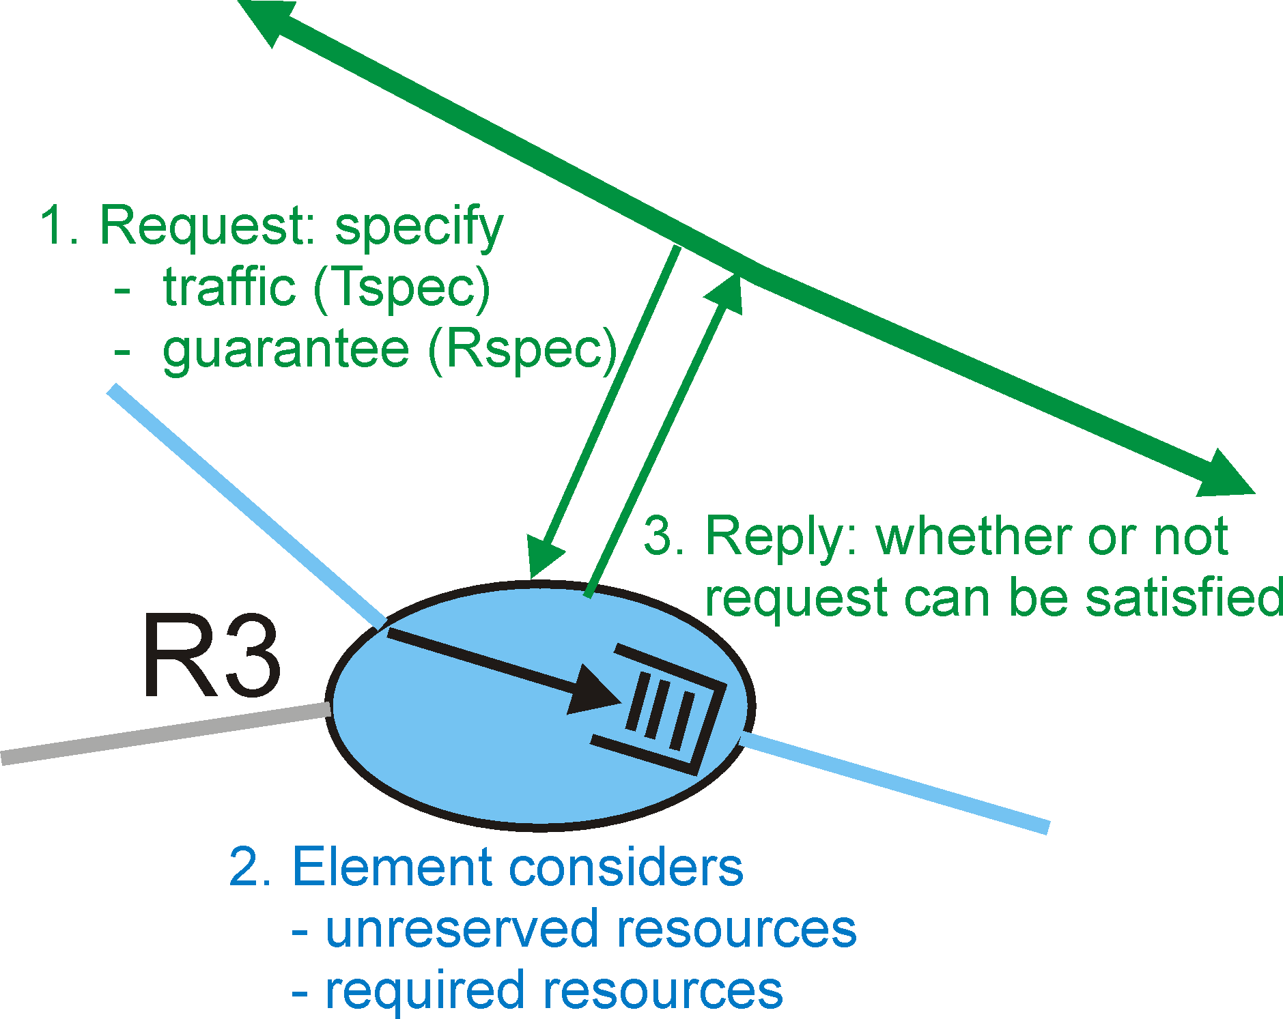
Call Admission
Call Admission: routers will admit calls based on their R-spec and T-spec and base on the current resource allocated at the routers to other calls.

Slide 45
Differentiated Services
Intended to address the following difficulties with Intserv and RSVP;
Scalability: maintaining states by routers in high speed networks is difficult due to the very large number of flows
Flexible Service Models: Intserv has only two classes, want to provide more qualitative service classes; want to provide ‘relative’ service distinction (Platinum, Gold, Silver, …)
Simpler signaling: (than RSVP) many applications and users may only want to specify a more qualitative notion of service

Slide 46
Diffserv - Motivation
Do fine-grained enforcement only at the edge of the network.
  Typically slower links at edges
  E.g., mail sorting in post office
Label packets with a field.
  E.g., a priority stamp
The core of the network uses only the type field for QoS management.
  Small number of types with well defined forwarding behavior
  Can be handled fast
Example: expedited service versus best effort
Evolution rather than revolution

Slide 47
Diffserv - Discussion
Diffserv defines an architecture and a set of forwarding behaviors.
  It is up to the service providers to define and implement end-to-end services on top of this architecture.
  Offers a more flexible service model; different providers can offer different service.
One of the main motivations for Diffserv is scalability.
  Keep the core of the network simple.
Focus of Diffserv is on supporting QoS for flow aggregates.
  Although architecture does not preclude more fine-grained guarantees.

Slide 48
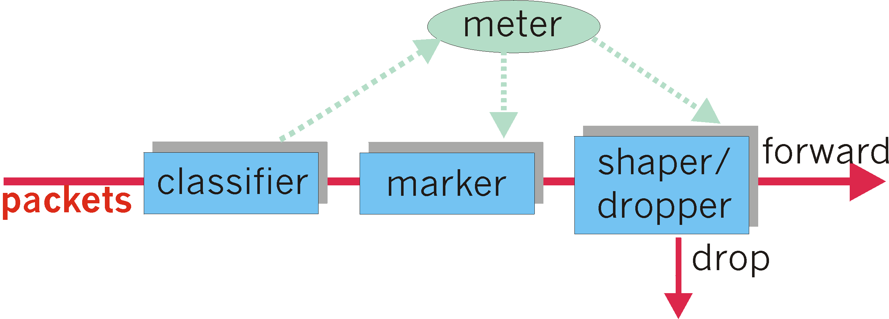
Edge Router/Host Functions
Classification: marks packets according to classification rules to be specified.
Metering: checks whether the traffic falls within the negotiated profile.
Marking: marks traffic that falls within profile.
Conditioning: delays and then forwards, discards, or remarks other traffic.

Slide 49

Classification and Conditioning
Packet is marked in the Type of Service (TOS) in IPv4, and Traffic Class in IPv6.
6 bits used for Differentiated Service Code Point (DSCP) and determine PHB that the packet will receive.
2 bits are currently unused.

Slide 50
Core Functions
Forwarding: according to “Per-Hop-Behavior” or PHB specified for the particular packet class; such PHB is strictly based on class marking (no other header fields can be used to influence PHB).
BIG ADVANTAGE:
No state info to be maintained by routers!

Slide 51
Forwarding (PHB)
PHB result in a different observable (measurable) forwarding performance behavior.
PHB does not specify what mechanisms to use to ensure required PHB performance behavior.
Examples:
  Class A gets x% of outgoing link bandwidth over time intervals of a specified length.
  Class A packets leave first before packets from class B.

Slide 52
Forwarding (PHB)
Expedited Forwarding (EF):
  Guarantees a certain minimum rate for the EF traffic.
  Implies isolation: guarantee for the EF traffic should not be influenced by the other traffic classes.
  Admitted based on peak rate.
  Non-conformant traffic is dropped or shaped.
  Possible service: providing a virtual wire.

Slide 53
Forwarding (PHB)
Assured Forwarding (AF):
  AF defines 4 classes with some bandwidth and buffers allocated to them.
  The intent is that it will be used to implement services that differ relative to each other (e.g., gold, silver,…).
  Within each class, there are three drop priorities, which affect which packets will get dropped first if there is congestion.
  Lots of studies on how these classes and drop priorities interact with TCP flow control.
  Non-conformant traffic is remarked.

Slide 54
Example of EF: A Virtual Leased Line Service
Service offers users a dedicated traffic pipe.
  Guaranteed bandwidth between two points.
  Very low latency and jitter since there should be no queuing delay (peak rate allocation).
Admission control makes sure that all links in the network core have sufficient EF bandwidth.
  Simple case: sum of all virtual link bandwidth is less than the capacity of the slowest link.
Traffic enforcement for EF traffic limits how much EF traffic enters the network.

